Slide 1
Visualization of climate data.
Hongyun Sheng
Mohan Liu
Wei Zou
Based on location prediction

Slide 2
Clarification
Actually, we prepare to do Instagram Analysis and data visualization based on the location. Unfortunately, Instagram denied our application. And they shut down the API to access their data. Since our goal is to get the most popular places around the world and visualize results, we decide to change the dataset as climate to do analysis and visualization. The topic has been changed but the project type and goals are similar.

Slide 3
Intro
The purpose of this project is to analyze the temperature data and visualize them based on the location.

Slide 4
Goals of the project
The project is aim to visualize the evolution of temperatures over time and temperature deviations over time in all over the world.
The development in this application will involve transforming data provided from weather stations into meaningful information.
Making images from the information by using spatial and linear interpretation techniques, and finally, implementing the user interface.

Slide 5
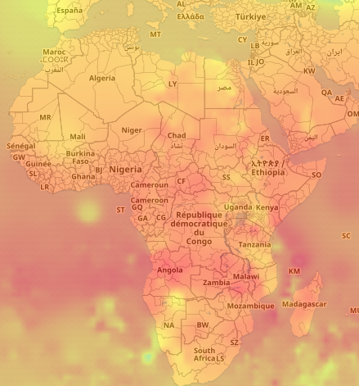
Use cases to be satisfied for hypothetical customers
Since the raw data is hard to analysis, our project will help users see the annual temperature changes and the deviations for every year more intuitively. Users will know where the temperature changes most so that they can take some actions on the location that has extreme temperature.(etc.Weather forecast.)
Using this analysis and visualization technology for other information/industry: Example: Popular travel location, Popular topics based on Locations.
The project can be used to generate popularity heat map. (Changing temperature data to popularity data).
With popularity analysis and heat map, Users/business could analyze the popularity based on Location to make an appropriate business strategy. (e.g. Geo-targeting Ad, Contextual Targeting, Social Media Marketing).
Notes:
具体例子，users 要干什么，businesses要干啥

Slide 6
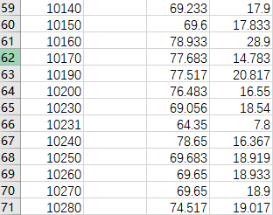
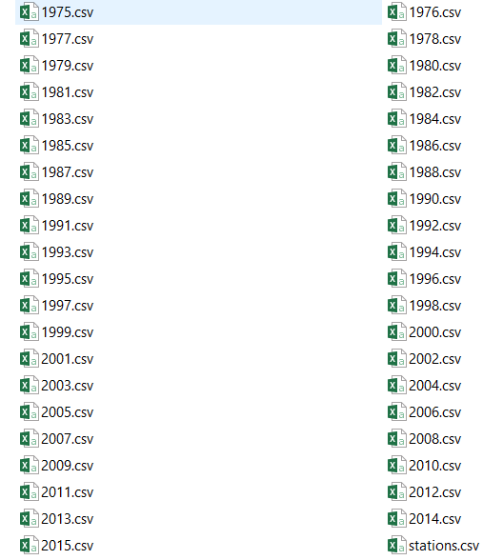
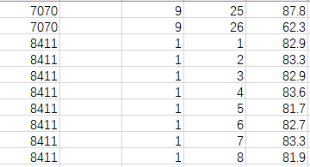
Data sources
Data type: stations.csv year.csv
Total size of data: 2.1GB
100k stations data
41 years temperature data
Notes:
要确切的数字
需要多少instagram

Slide 7
Data extraction and Data clean
1.Iterate the files and parse the data into separate sequences.
2. Map temperature and location return a seq containing triplets(date, location, temperature)
(LocalDate.of(2015, 8, 11), Location(37.35, -78.433), 27.3),)
3. Calculate annual average temperature and return a seq (location, temperature) for each year.
Methodology

Slide 8
Data manipulation
To explore more information from temperature data.
We want to know more about how huge changes and difference over years.
⇒ Calculate deviations.
Calculate Average temperature among years.
Compare yearly data with average
Improvement:
Lazy RDD
Instead of Pre-calculate all temperatures and return a getter function We calculate values when requested, using memoization to avoid recalculations
Methodology

Slide 9
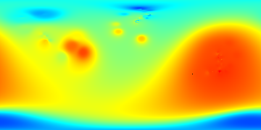
Data visualization
1.Predict temperature.
The data of temperature is not consecutive, which is a set of scattered points.
So in terms of location without temperature data, we predicted temperature by Spatial interpolation.
We used IDW algorithm (Inverse Distance Weighting), a type of deterministic method for multivariate interpolation with a known scattered set of points.
2. Link temperature with color by Linear interpolation
3. Get each pixel’s corresponded color, and present them in a image.
Based on Year 2015 data ⇒
Methodology

Slide 10

Produce images compatible with web-based map
The whole map is divided into small images, called tiles.
1.Tile generation:
Tile is presented by (x value, y value, zoom level).
Example: 2-1-1 tile in Year 1975
Zoom level 2, Bottom-right (1, 1)
2. Link position with map
Convert geographic position to its corresponding GPS coordinates
applying the Web Mercator projection.
Methodology

Slide 11
Using Scala JS to build UI
After tills generation, we linked them to a dynamic UI.
Layers
Signal[Layer] to show the value over time of the enabled layer
This URL pattern is used by the mapping library to retrieve the tiles
Methodology

Slide 12
Acceptance criteria
Project can deal with large quantity of data.
Temperature prediction works well. The result can show the complete heat map.
Color for the temperature in each station is accurate
The color for deviation can show the most changes correctly.

Slide 13
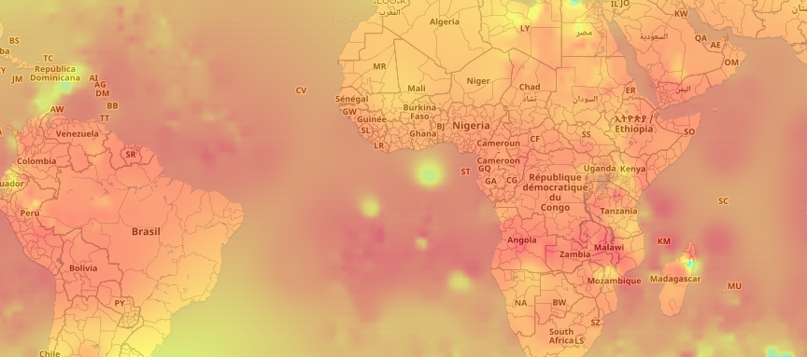
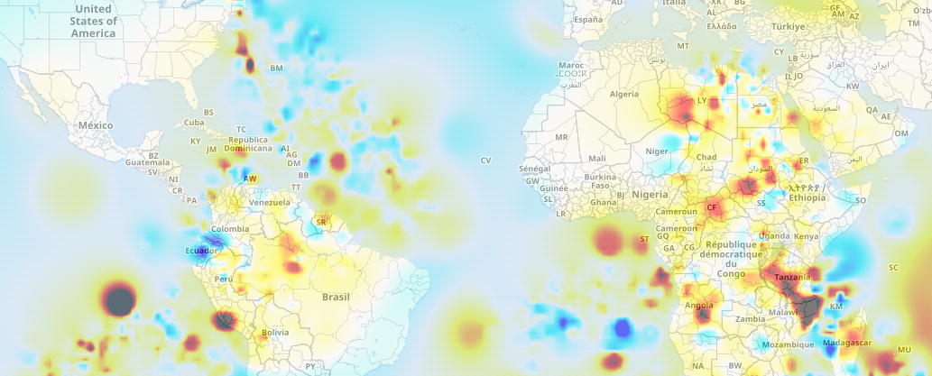
Result
Temperatures Deviations

Slide 14

Thanks!

